Slide 1
San Diego Region
Stormwater Capture & Use
Feasibility Study (SWCFS)
Technical Advisory Committee (TAC) Meeting #4
Results of Prioritization Analysis
May 4, 2018
Presented by County of San Diego, ESA, Katz & Associates

Slide 2

Agenda
Welcome & Introductions
Recap & Status of Project to Date
Cost Results Presentation
Prioritization Results Presentation
Discussion of Constraints and Opportunities
Public Questions & Comments

Slide 3





Welcome & Introductions
Project Team:
County of San Diego – Stephanie Gaines
Consultant Team:
  ESA – David Pohl, Lindsey Sheehan
  Brown & Caldwell – Lisa Skutecki, Hari Seshan
  Burns & McDonnell – Steve Gruber, Galen Kenoyer
  Katz & Associates – Lewis Michaelson, Natalia Hentschel

Slide 4
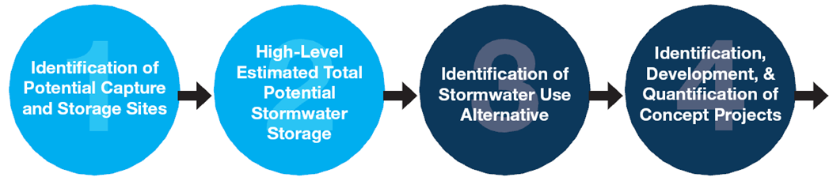
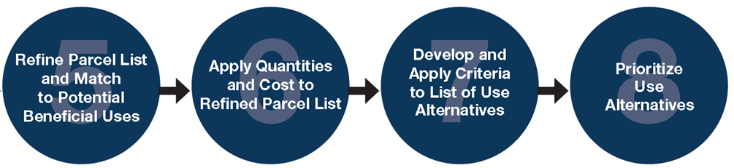
Where are we in the Feasibility Study?
✓
✓
✓
✓
✓
⬆
⬆
⬆

Slide 5
Cost Analysis Results
Assumptions and concept costs presented in technical memorandum – distributed to TAC
Conceptual costs developed for “modeled” parcels for applicable Alternatives
Costs per volume basis - wide range
  Dry weather flows increase total annual volume
  More effective drainage area vs. capture design
  Matching demand/discharge restrictions with storage
  Pre-treatment requirements

Slide 6
Stormwater Use Alternatives
 | Eight Stormwater Use Alternatives
A | Direct discharge to designated groundwater aquifers to be extracted for potable use
B | Discharge to groundwater to reestablish natural hydrology and, by extension, to restore biological uses
C | Irrigation to be used on-site or at nearby parks, golf courses, or recreational areas on public parcels
D | Small scale on-site use for irrigation and other private use on private parcels
E | Flow-through to sustain vegetation in natural treatment system (wetland treatment) and/or restoration sites
F | Controlled discharge to waste water treatment plants for solids management during low flows
G | Controlled discharge to waste water treatment plants for indirect potable use
H | Controlled discharge to waste water treatment plants for recycled water use

Slide 7
Alternative Prioritization Criteria & Metrics
Potential Volume: acre-feet/year
Unit Cost: $/acre-foot (annual volume)
Additional Benefits (number of benefits)
Constraints and Opportunities
(qualitative assessment of constraints and opportunities developed by TAC)

Slide 8
Capture and Use Volume Criterion
Volumes from modeled parcels
Range of volumes based on:
  More feasible parcels (low end of total volume)
  Potentially constrained sites (higher end of total volume)
Score used:
  % of parcels in each volume range for the two sets
  # of parcels that make up the highest-percentage volume range

Slide 9
Capture and Use Volume Scoring
Scoring to Account for Wide Range of Volumes
Use both sets of volumes (feasible / potentially constrained parcels)
Categorize distribution of volumes
  Less than 25th percentile → Low (+1)
  Between 25th and 75th percentile → Medium (+2)
  Above 75th percentile → High (+3)
Use highest percentage of parcels in distribution categories for both sets
To favor more feasible parcels: score is multiplied by 2

Slide 10
Capture and Use Volume Scoring
Additional scoring to account for actual number of feasible parcels – Percentage doesn’t account for Potential Regional Volume
  5 or fewer parcels → Low (+1)
  5 to 10 parcels → Medium (+2)
  More than 10 parcels → High (+3)

Slide 11
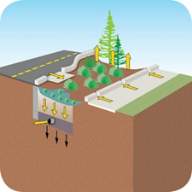
Capture and Use Volume
Example: Green Streets – Alternative B
 | Feasible Parcels (Lower Number of Site)
Alternative | Low (1) | Medium (2) | High (3) | Parcels in Category | Parcel Count Score (x1) | Volume Score (x2)
A | 7% | 64% | 29% | 9 | 2 | 4
A (injection) | 0% | 33% | 67% | 4 | 1 | 6
B | 28% | 67% | 5% | 38 | 3 | 4
C | 38% | 63% | 0% | 10 | 2 | 4
D | 100% | 0% | 0% | (Many) | 3 | 2
E | 0% | 100% | 0% | 25 | 3 | 4
F | 40% | 40% | 20% | 2 | 1 | 4
G | 40% | 40% | 20% | 2 | 1 | 4
H | 40% | 40% | 20% | 2 | 1 | 4
 | Potentially Constrained (Higher Number of Sites)
Alternative | Low (1) | Medium (2) | High (3) | Volume Score (x1) | Total Score
A | 2% | 90% | 8% | 2 | 8
A (injection) | 4% | 3% | 94% | 3 | 10
B | 9% | 89% | 2% | 2 | 9
C | 8% | 91% | 1% | 2 | 8
D | 100% | 0% | 0% | 1 | 6
E | 0% | 100% | 0% | 2 | 9
F | 0% | 100% | 0% | 2 | 7
G | 0% | 100% | 0% | 2 | 7
H | 0% | 100% | 0% | 2 | 7
Notes:
Use Alternative B – Infiltration for Hydrology
Volume score for feasible parcels
67% of parcels are in the middle category → Medium (+2x2=+4)
Parcel count score for feasible parcels
38 feasible parcels are in that category → High (+3)
Volume score for potentially constrained parcels
89% of parcels are in the middle category → Medium (+2)
Total Score: 4 + 3 + 2 = 9

Slide 12
Cost Criterion
Unit Cost $/acre-foot =
  Total cost / total stormwater volume
Compared to cost of providing potable water from desalination (threshold)
Notes:
Total cost including design, permitting, and operations & maintenance over the project life divided by the total stormwater volume used over the project life

Slide 13
Unit Cost Analysis Results
Alternative | Project Type | Cost per Volume (average of low and high cost range - $/ac-ft)
Alternative A | Infiltration | $20,000- $33,000
 | Injection | $3,600 - $9,800
Alternative B | Infiltration | $17,000 - $20,300
 | Bio-Infiltration | $29,300 - $37,000
Alternative C | Irrigation | $118,700 - $186,100
Alternative D | Rain Barrels | $2,500
Alternative E | Restoration and Treatment Wetlands | $740 - $990
Alternative F | Dry-Weather Diversion | $9,600 - $21,400
Alternative G | Treatment for Recycled Water | $99,300 – $173,000
Alternative H | Treatment for Potable Water | $101,244 – $172,500
Desalination | $2,131 - $2,397

Slide 14
Cost Criterion
For each alternative, group feasible parcels by a unit cost threshold:
  Low Cost is less than $2,500/AF (cost for desal)
  High Cost is greater than $2,500/AF
Take the difference between the % of low-cost parcels and the % of high-cost parcels
Multiply by 10 - Weighting factor: cost is a major constraint to alternative and project feasibility

Slide 15
Unit Cost
Example: Green Streets – Alternative B
 | Percent of Feasible Parcels (+%) | Percent of Feasible Parcels (-%) | Score
Alternative | Low < $2,500 | High > $2,500 | (Low%-High%)/10
A (Infiltration to Groundwater Basin) | 32.5% | -67.5% | -3.5
A (Injection to Groundwater Basin) | 50% | -50% | 0
B (Infiltration for Hydrology) | 17.5% | -82.5% | -6.5
C (Irrigation) | 0 | -100% | -10
D (Private On-Site Use) | 100% | 0 | 10
E (Use for Treatment Wetland) | 100% | 0 | 10
F (WWTP Solids Management) | 20% | -80% | -6
G (WWTP for Potable Use) | 0 | -100% | -10
H (WWTP for Recycled Use) | 0 | -100% | -10
Notes:
Use Alternative B – Infiltration for Hydrology
Divide parcels by cost
17.5% are less than $2,500/AF
82.5% are greater than $2,500/AF
Take the difference
17.5% - 82.5% = -65%
Multiply by 10 – Cost Score is Weighted
-65% x 10 = -6.5

Slide 16
Additional Benefits Criterion
For each alternative, identify potential for additional benefits
(based on the San Diego SWRP)
  Water Quality (+1)
    Additional (+1) for projects designed for this purpose
  Flood Management (+1)
  Environment (+1)
  Community (+1)

Slide 17
Additional Benefits
Example: Green Streets – Alternative B
Alternative | Water Quality (1-2 points) | Flood Management (1 point) | Environment (1 point) | Community (1 point) | Total
A (Infiltration to Groundwater Basin) | ✓ | ✓ | ✓ |  | 3
A (Injection to Groundwater Basin) | ✓ | ✓ | ✓ |  | 3
B (Infiltration for Hydrology) | ✓+ | ✓ | ✓ | ✓ | 5
C (Irrigation) | ✓ | ✓ |  | ✓ | 3
D (Private On-Site Use) | ✓ | ✓ | ✓ | ✓ | 4
E (Use for Treatment Wetland) | ✓+ | ✓ | ✓ | ✓ | 5
F (WWTP Solids Management) | ✓+ | ✓ |  |  | 3
G (WWTP for Potable Use) | ✓ | ✓ |  |  | 2
H (WWTP for Recycled Use) | ✓ | ✓ |  |  | 2
Notes:
Use Alternative B – Infiltration for Hydrology
Water Quality
These projects designed to improve water quality. (+2)
Flood Management
Detaining runoff may reduce flooding. (+1)
Environment
These projects return water to natural hydrology, providing an environmental benefit. (+1)
Community
These projects provide many opportunities to engage the community. (+1)
Total Score: 2 + 1 + 1 + 1 = 5

Slide 18
Constraints and Opportunities Criterion
Basis:
  Informed by the constraints and opportunities identified for each example project
  Constraints and opportunities identified for each alternative
Scoring:
  For each constraint or closed “gate”, alternative gets (-1)
  For each opportunity or open “gate”, alternative gets (+1)

Slide 19

Constraints and Opportunities
Example: Green Streets – Alternative B
Constraints “Gates”
Site Characteristics
Match Production with Demand/Need
Absence of Existing Infrastructure Capacity
Agency Agreements
Water Type Incompatibility/ Treatment Requirements
Regulatory Ambiguity/ Not Specific to Stormwater
Capital and O&M Costs / Funding
Public/Agency Support
Open Gates 7
Closed Gates -1
Total 6

Slide 20
Constraints and Opportunities
Results – All Alternatives
Alternative | A | B | C | D | E | F | G | H
Open Gates | 5 (6)¹ | 7 | 4 | 5 | 7 | 5 | 3 | 2
Closed Gates | 3 (2)¹ | 1 | 4 | 3 | 1 | 3 | 5 | 6
Total | 2 (4)¹ | 6 | 0 | 2 | 6 | 2 | -2 | -4
1. Scores outside parentheses are for Alternative A via infiltration, while those inside parentheses are for Alternative A via injection.

Slide 21
Results: Combined Feasibility Scores
Alternative | Capture and Use Volume | Unit Cost | Additional Benefits | Constraints and Opportunities | Total | Time Horizon (Term)
E (Natural Treatment System) | 9 | 10 | 5 | 6 | 30 | Near-
D (Private – residential rain barrels, downspout disconn. – capture & use by larger commercial & industrial | 6 | 10 | 4 | 2 | 22 | Near-
A (Injection to Groundwater Basin) | 10 | 0 | 3 | 4 | 17 | Near-
B (Infiltration for Hydrology – green streets | 9 | -6.5 | 5 | 6 | 13.5 | Near-
A (Infiltration to Groundwater Basin) | 8 | -3.5 | 3 | 2 | 9.5 | Near to Mid-
F (WWTP Solids Management – dry weather flows) | 7 | -6 | 3 | 2 | 6 | Mid-
C (Irrigation – on-site or nearby public park) | 8 | -10 | 3 | 0 | 1 | Mid to Long-
G (Capture & Convey to WWTP for Potable Use) | 7 | -10 | 2 | -2 | -3 | Long-
H (Capture & Convey to WWTP for Recycled Use) | 7 | -10 | 2 | -4 | -5 | Long-

Slide 22
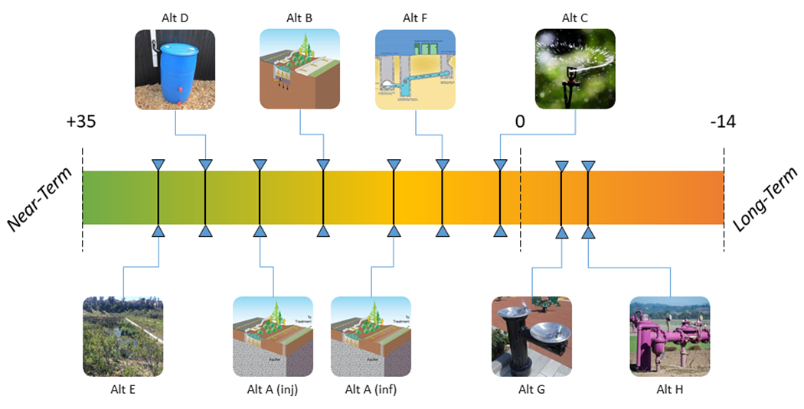
Feasibility Timeline

Slide 23
Group Discussion
Group input on Alternative scoring and prioritization
  Does it make sense?
  Were the outcomes what you expected?

Slide 24
Breakout Session
Break-out into Groups by Alternatives
Review hand-outs
  Constraints and opportunities table
  Constraints and opportunity scores
  Results of overall prioritization scoring
Discussion questions
  How can alternative(s) (assigned to your table) be moved up to a shorter timeline (higher priority)?
  Are there other opportunities to open existing gate (constraints)?

Slide 25
Breakout Groups
Use Alternative | Break Out Groups/Tables
A (Infiltration to Groundwater Basin) | Group 1
A (Injection to Groundwater Basin)
B (Infiltration for Hydrology – green streets) | Group 2
C (on-site and nearby public parcel Irrigation) | Group 2
D (Private On-Site Use – rain barrels, downspout disconnects, and industrial and commercial site use) | Group 2 – residential capture and use for irrigation Group 3 – larger commercial and industrial use
E (Use for Treatment Wetland) | Group 2
F (WWTP Solids Management – dry weather flow diversion) | Group 3 (2 tables as needed)
G (Stormwater capture and conveyance to WWTP for Potable Use) | Group 3 (2 tables as needed)
H (Stormwater capture and conveyance WWTP for Recycled Use) | Group 3 (2 tables as needed)

Slide 26
Next Steps
Comments due: May 25, 2018
Draft Feasibility Study to TAC: End of August 2018
Final TAC Meeting #5: Mid-September 2018
  Presentation of Feasibility Study (Final Report)
    What can we focus on to move higher priority alternatives forward?
    Where can we focus resources to open gates that will advance more constrained alternatives up in timeline?

Slide 27

Public Comments

Slide 28


Thank you!
Stephanie Gaines
Watershed Protection Program
stephanie.gaines@sdcounty.ca.gov
858-694-3493
David Pohl
DPohl@esassoc.com
760-497-3318
Lewis Michealson
Lmichaelson@KatzandAssociates.com

